Slide 1
QG omega equation
Brian Mapes
ATM 651
Fall 2023

Slide 2
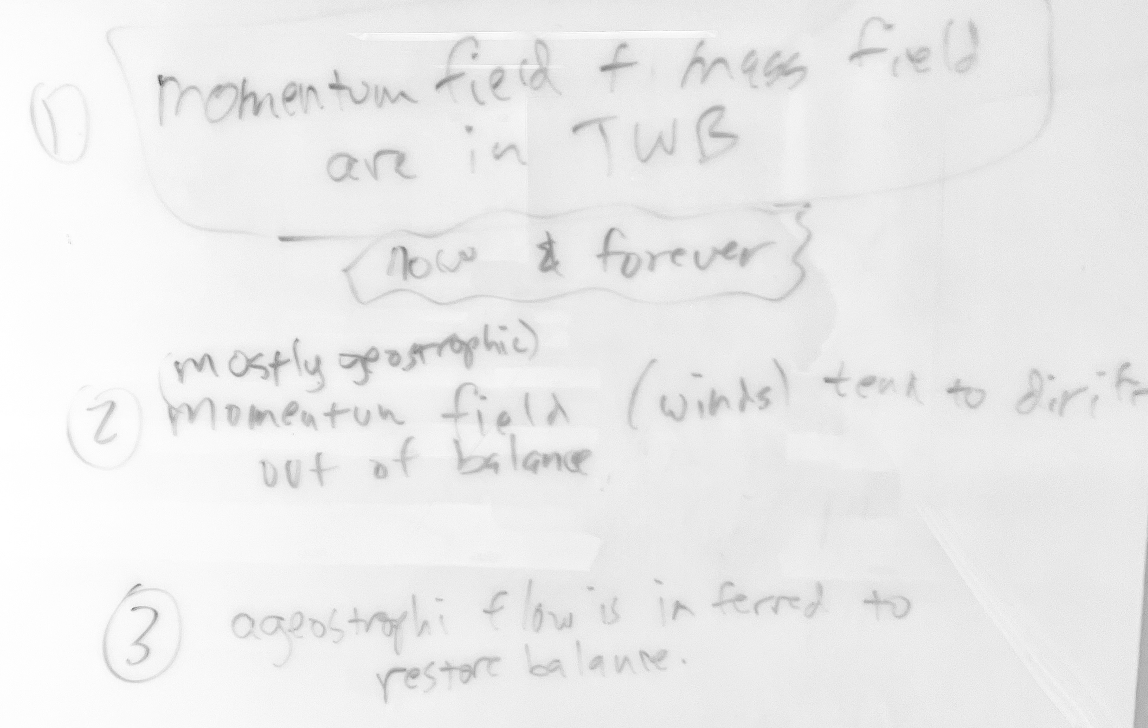
Principles and logical structure of idea 1. Balance of nature is disturbed, then restored (constantly, but let’s make it a drama )

Slide 3
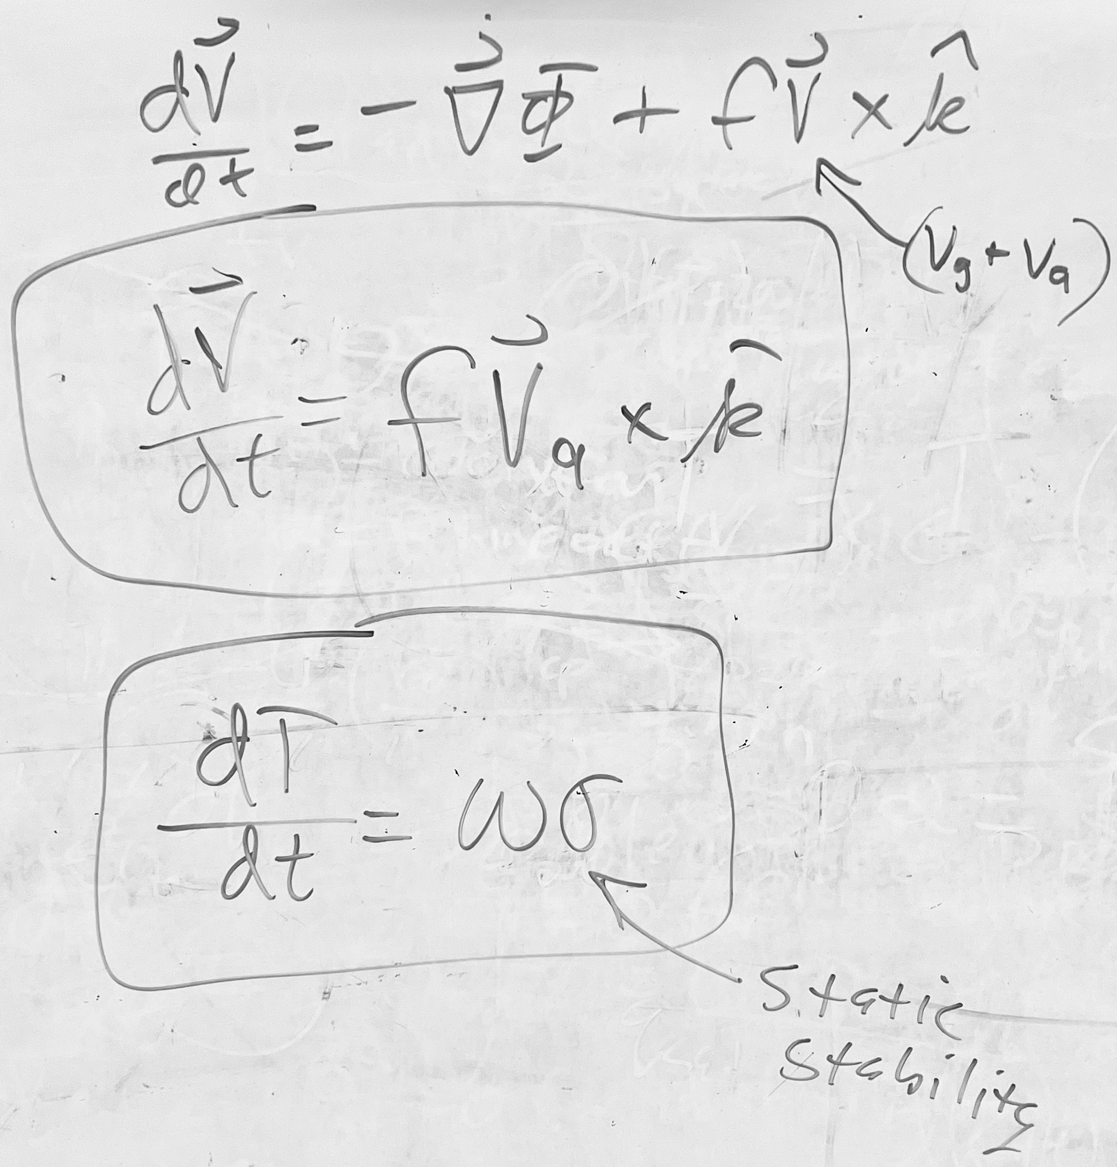
Principles and logical structure of idea 2. The available tools for adjustment: fVa, and adiabatic cooling by upward motion
Geostrophic wind (a “primary” circulation) contains most of the vorticity, and most of the wind motion that does the horizontal transporting (advection, or flux, your choice) of air properties (such as vorticity and heat)
But it is nondivergent and came from neglecting dV/dt, so it is a boring if adequate approximation
Va controls the acceleration of the wind, and also all the divergence (connecting to vertical motion by mass continuity). Vertical motion warms or cools air adiabatically in a stably stratified fluid (measured by positive static stability)

Slide 4
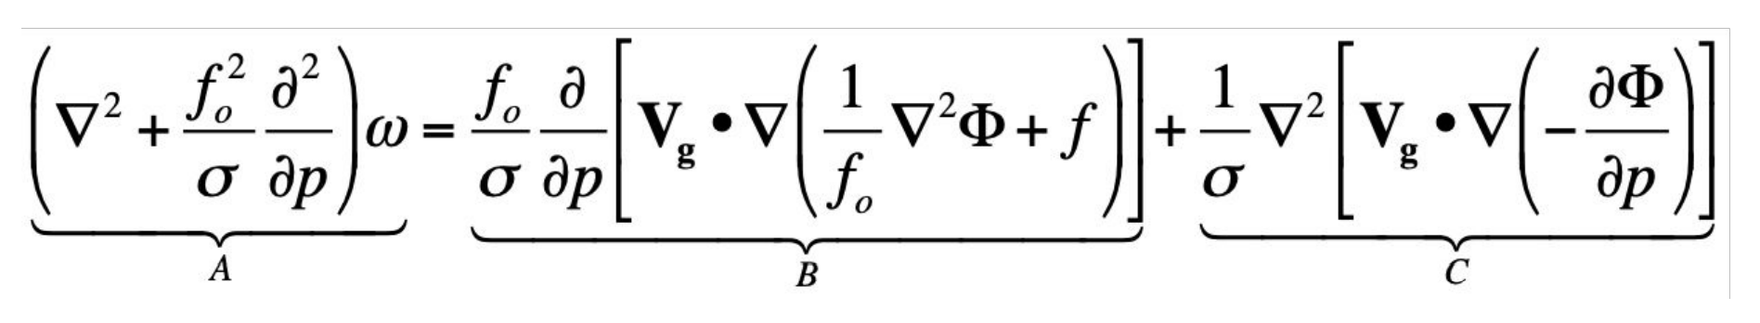
Derivations and maths
https://en.wikipedia.org/wiki/Omega_equation
https://snowball.millersville.edu/~adecaria/ESCI343/esci343_lesson02_QG_tendency_eqn.pdf
2

Slide 5

Part I: COMET/MetEd
Here is a nice tool for viewing the classic “wave” view of the QG omega equation. Give it a look – notice that hovering over equation terms lights up the names for them, or vice versa.
https://www.meted.ucar.edu/labs/synoptic/qgoe_sample/

Slide 6
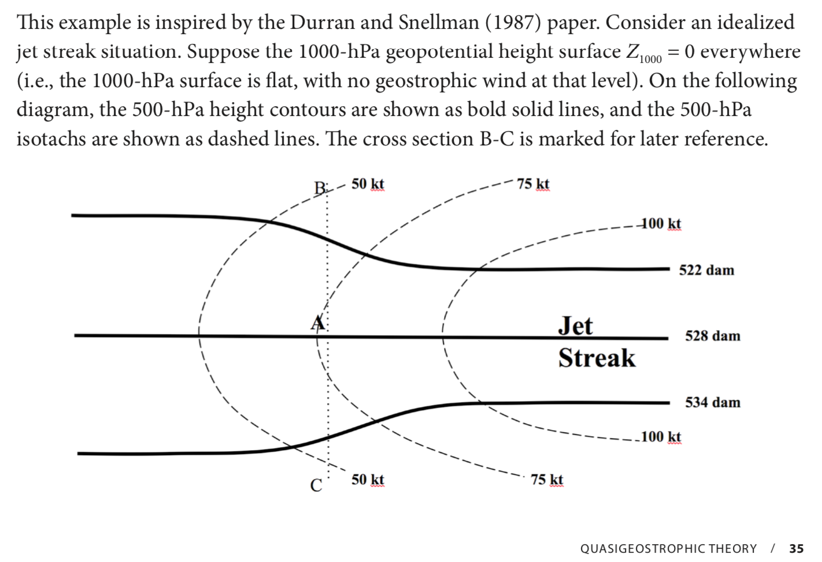
Part II: From the LMT lab book

Slide 7
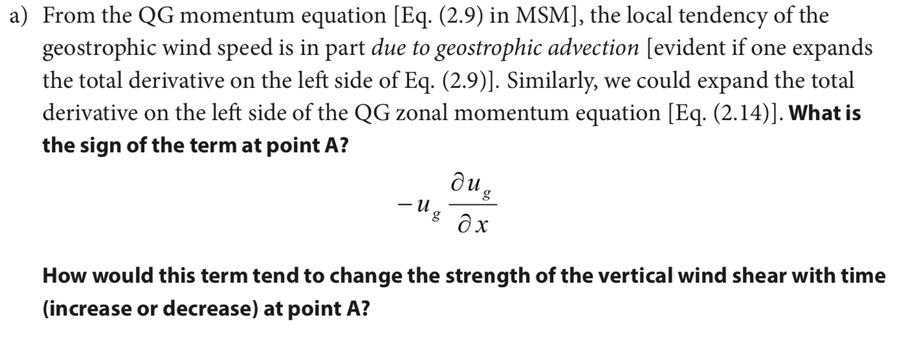

Slide 8
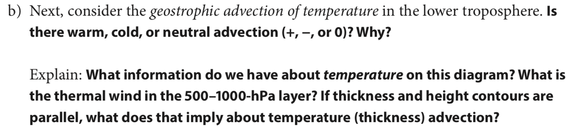

Slide 9
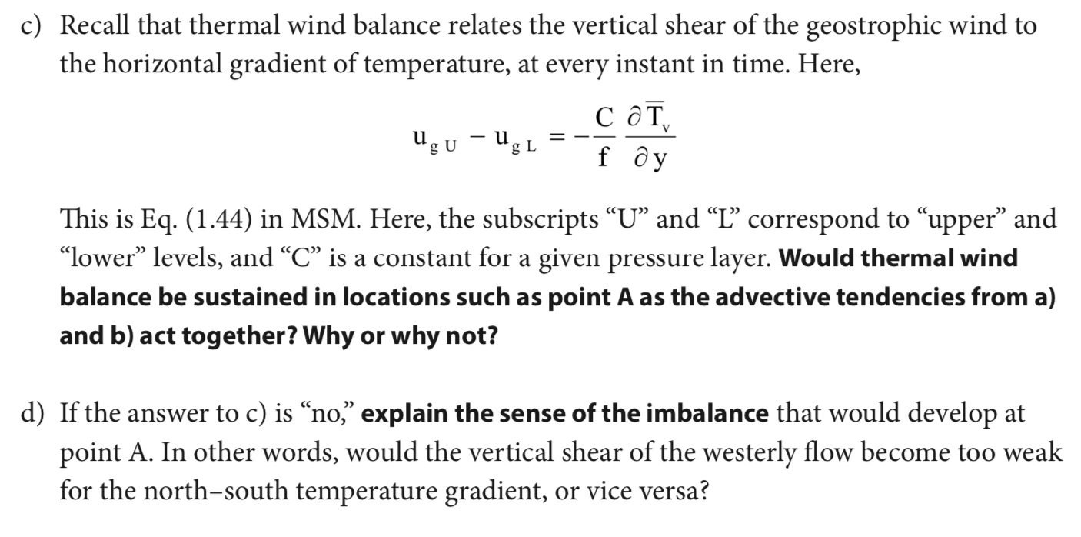

Slide 10
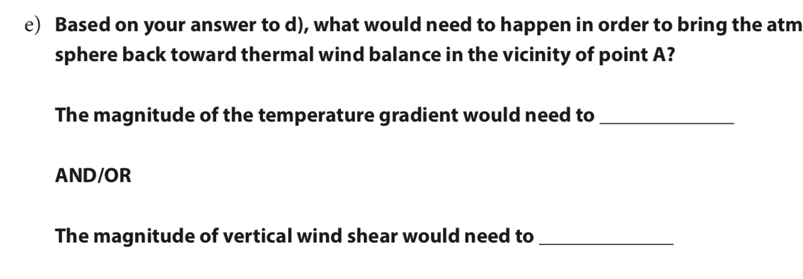

Slide 11
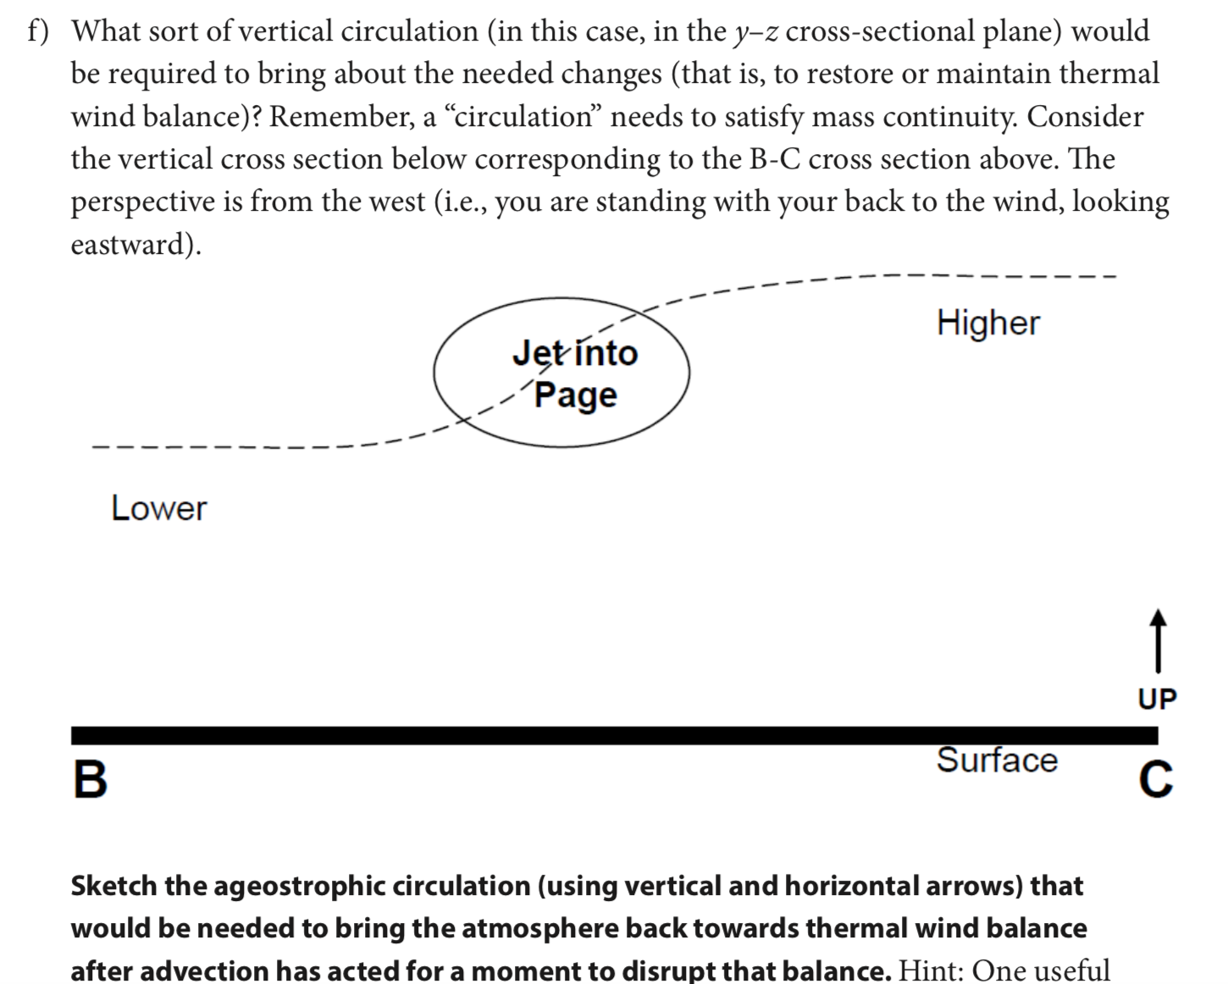
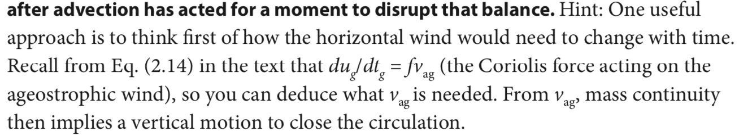
Part I: COMET/MetEd
North
South

Slide 12
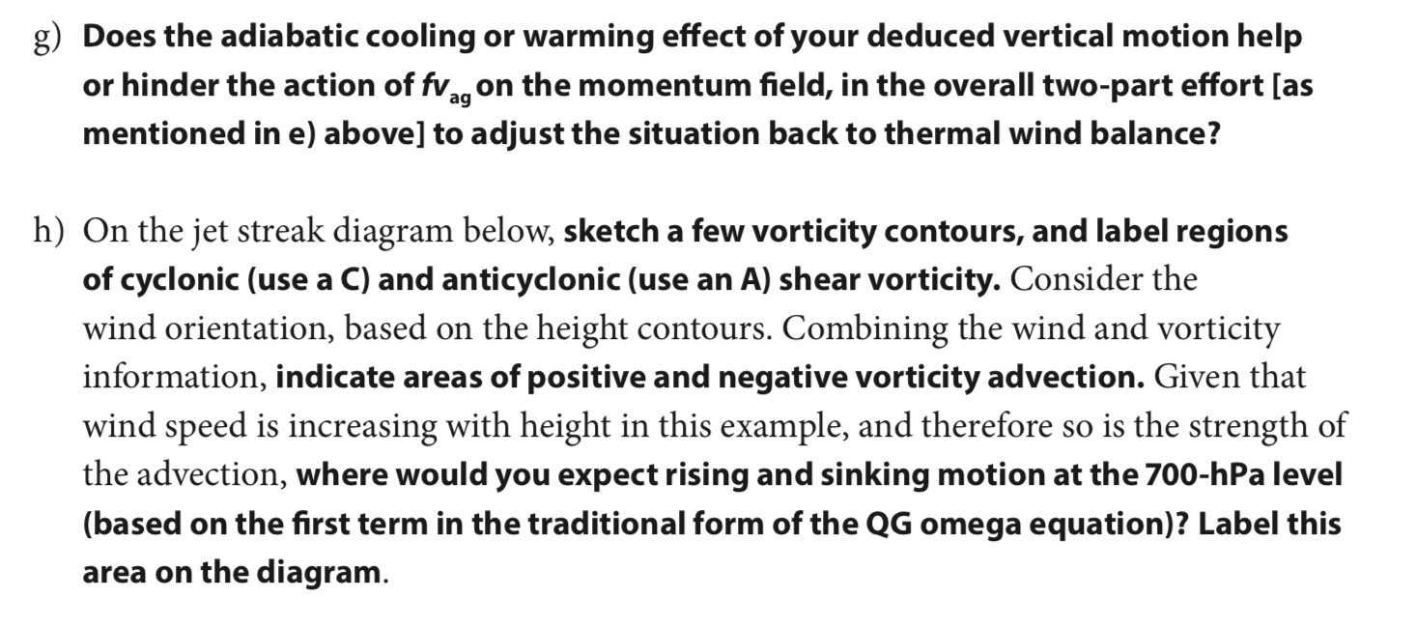
Part I: COMET/MetEd

Slide 13
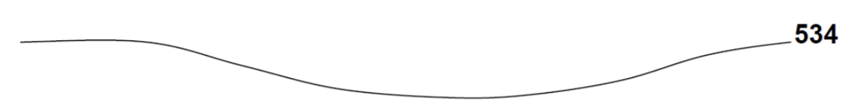
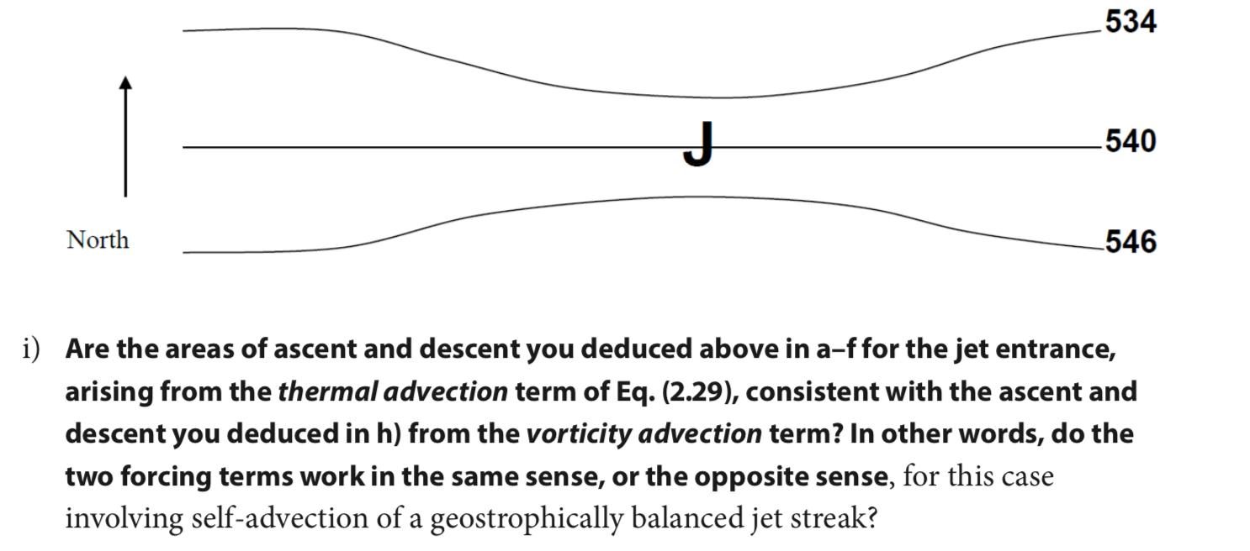
Sketch here with mouse
It’s just a trough

Slide 14
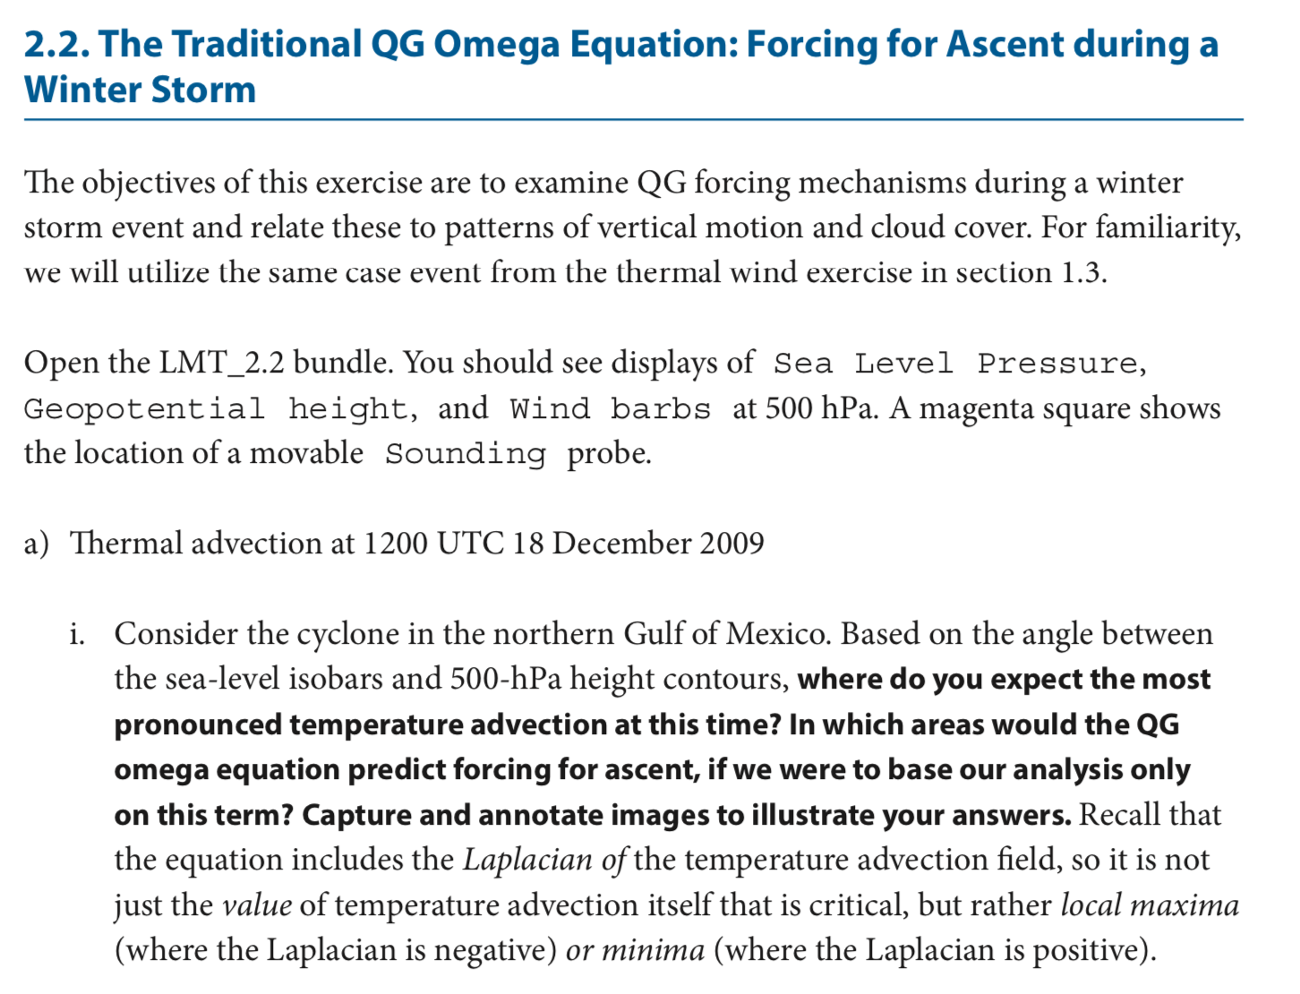
LMT2.2
Launch IDV
← From toolbar folders (there is triple redundancy) find LMT_2.2

Slide 15
LMT 2.2

Slide 16
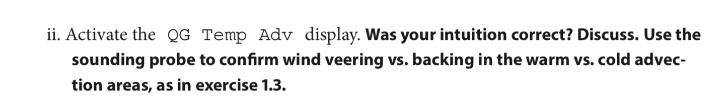
LMT 2.2

Slide 17
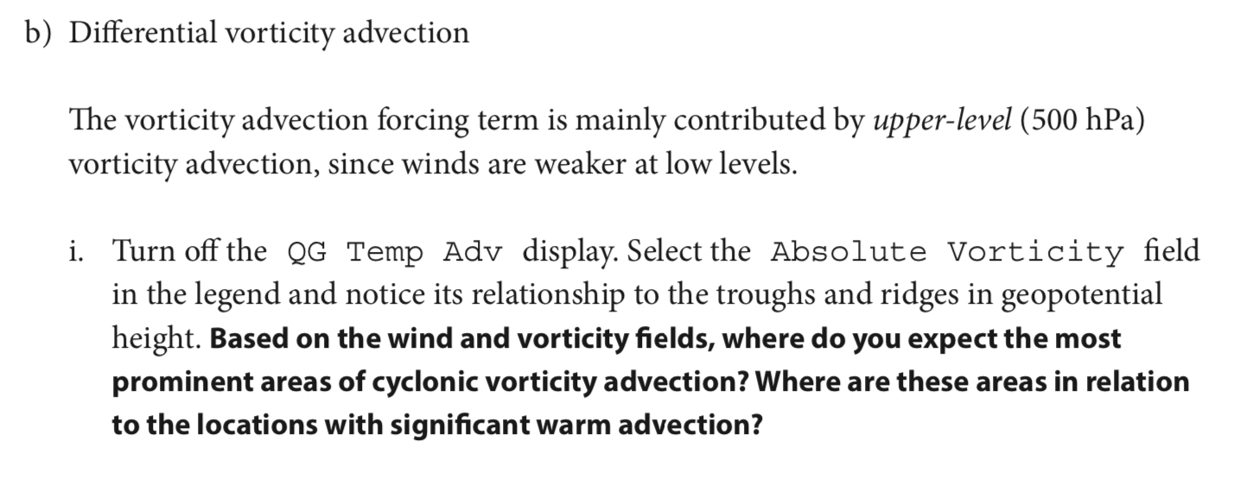
LMT 2.2

Slide 18
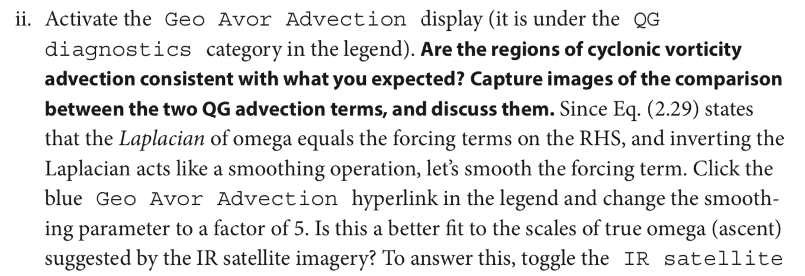
LMT 2.2

Slide 19
LMT 2.2

Slide 20
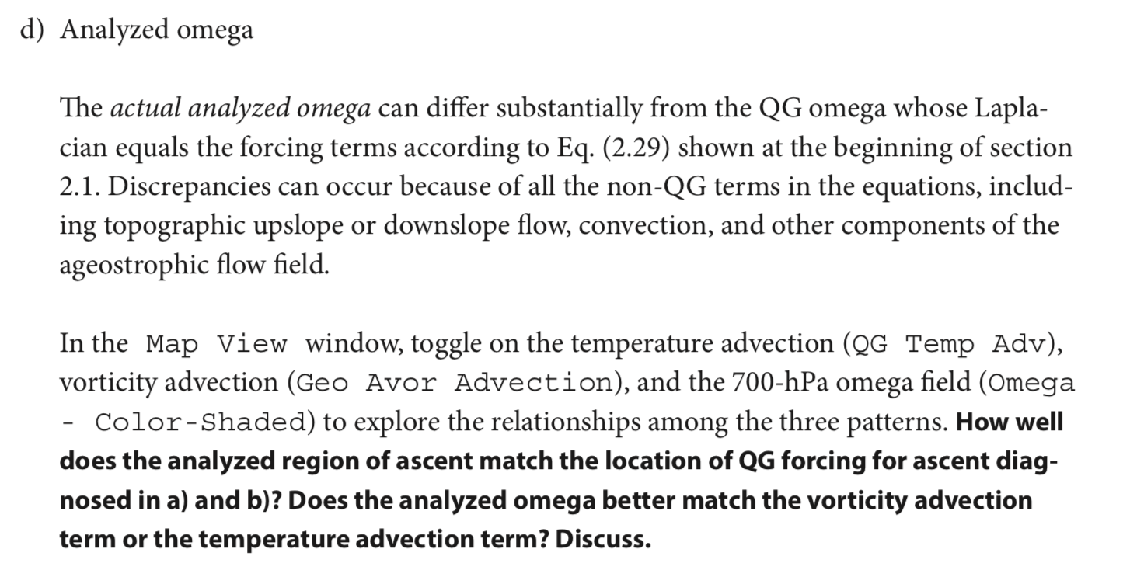
LMT 2.2

Slide 21
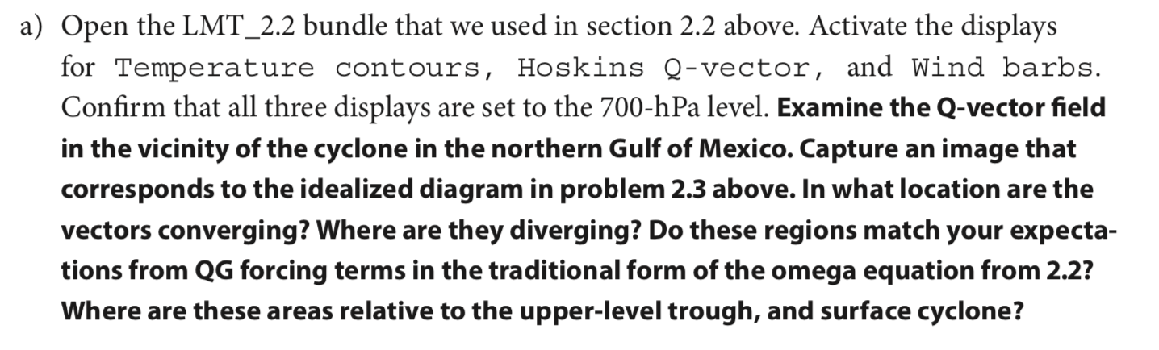
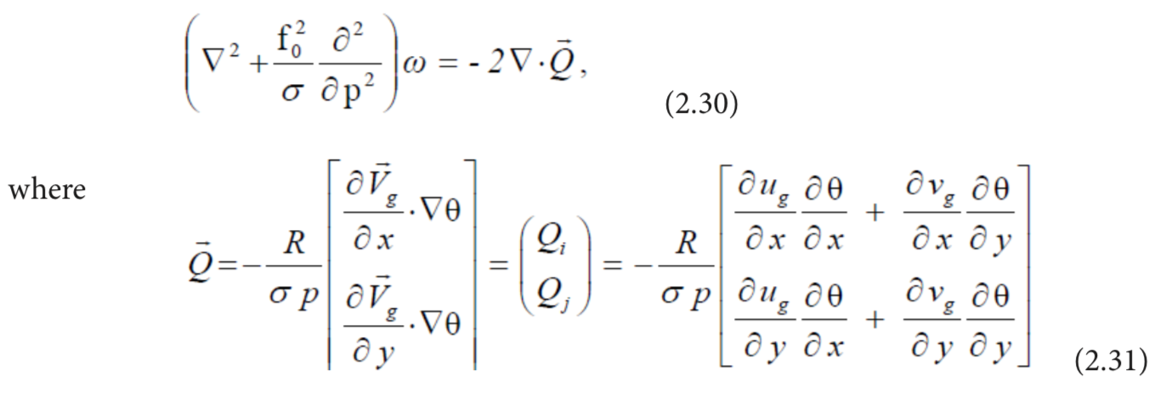
LMT 2.4 (same IDV bundle)

Slide 22
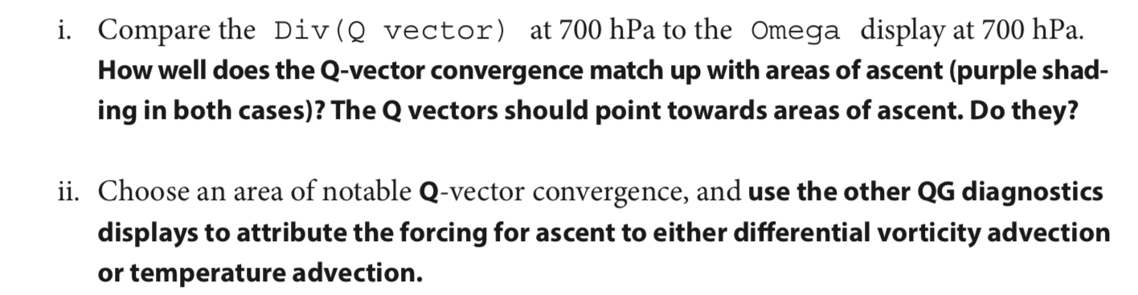
LMT 2.4 (same IDV bundle)

Slide 23
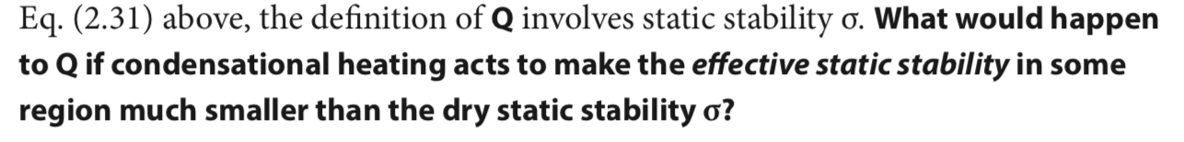
LMT 2.4 (same IDV bundle)

Slide 24
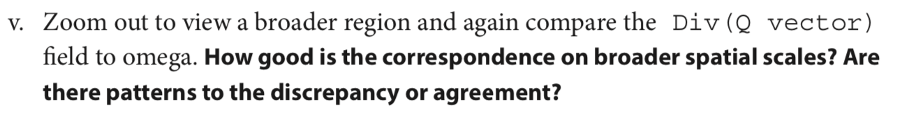
LMT 2.2

Slide 25
BACKGROUND ON QE OMEGA EQUATION

Slide 26
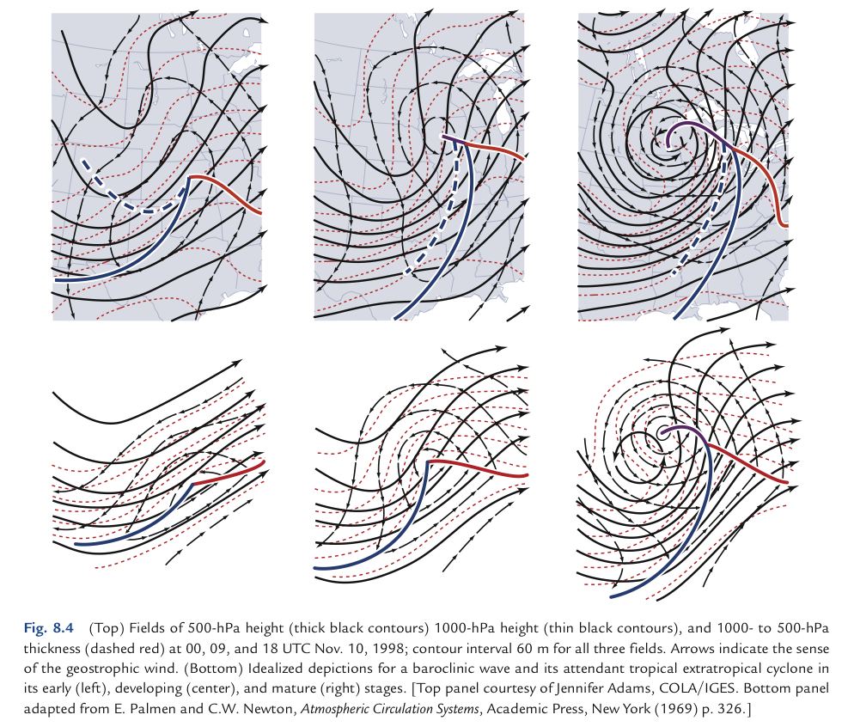
Wallace Hobbs ch8 case:
1969 textbook:

Slide 27
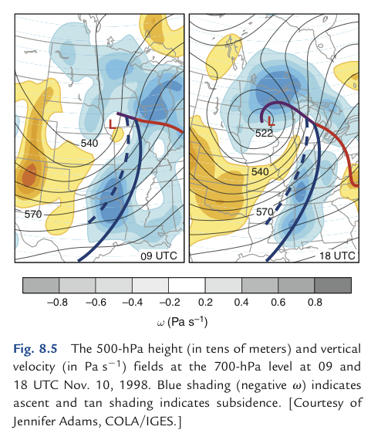
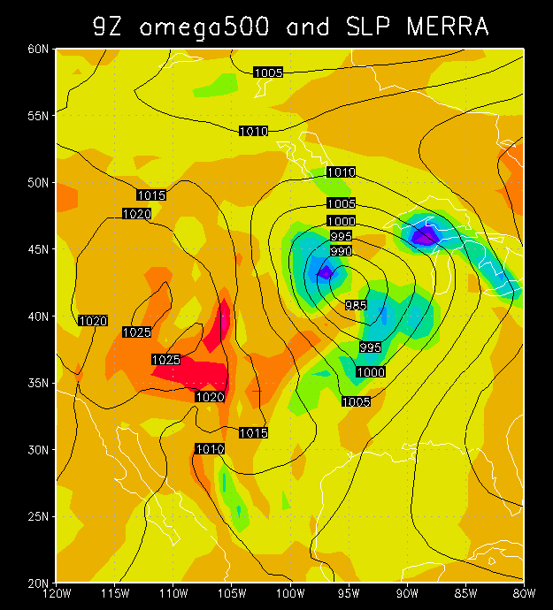
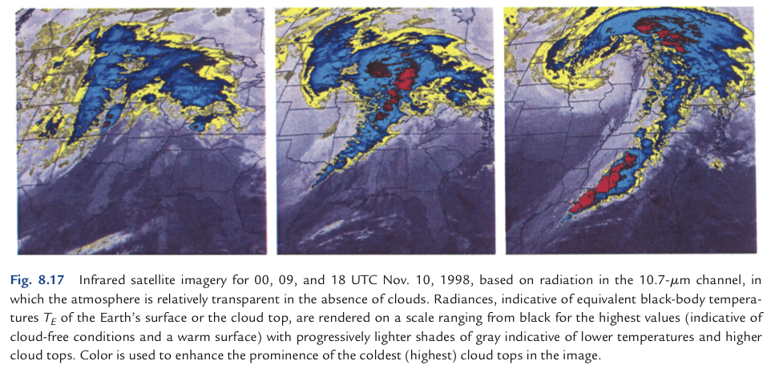

Slide 28
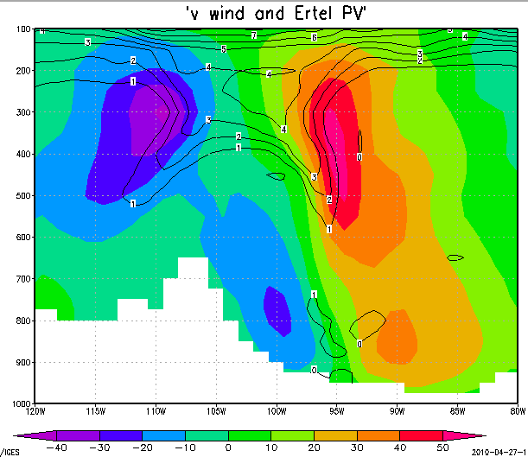

Slide 29
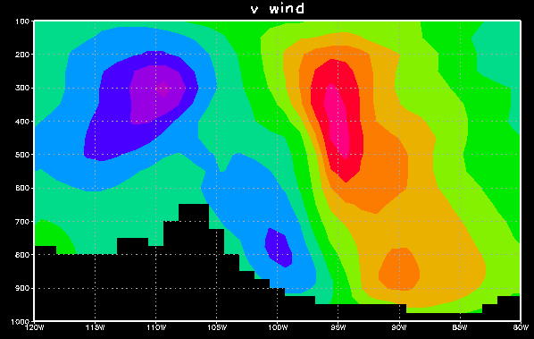
wind out of page
wind into page
cyclonic
(Trof on map)
cyclonic
Rockies
sfc Low

Slide 30
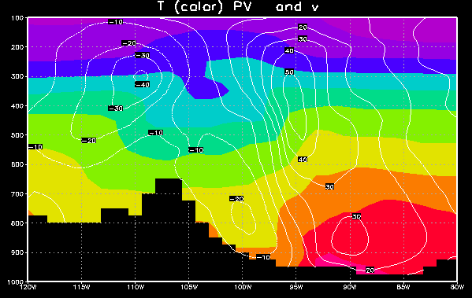
Meridional T advection
cooler air flowing south
warmer air flowing north
Low

Slide 31
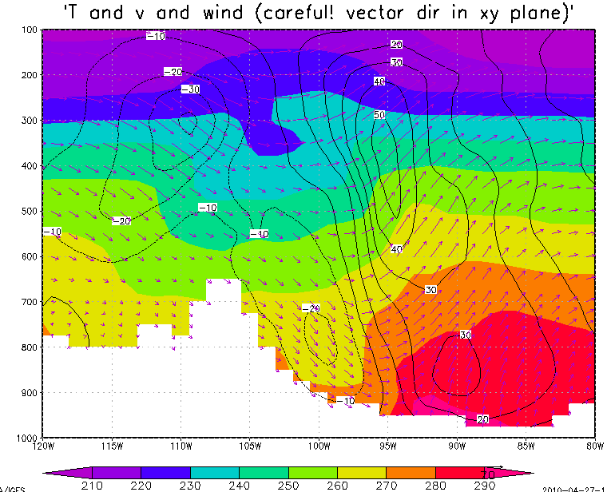
Veering/backing and T advection
TROF
winds backing with height
winds veering with height
cool air flowing south
cool air flowing south
warm air flowing north
warm air flowing north
Low

Slide 32
The omega equation
Why is there upward motion ahead of these upper-level troughs/ cyclonic vortices?

Slide 33
The omega equation
Why is there upward motion ahead of these upper-level troughs/ cyclonic vortices?
A: In order to maintain thermal wind balance, which holds across time, and thus we know logically it has a maintenance mechanism, as advection would tend to break the balance which holds at any one instant
Main mechanism: cooling by upward motion in a stratified fluid.

Slide 34
v and T: thermal wind balance
warm core above
cyclonic
(Trof)
cold core = low thickness
warm core
cyclonic
Low

Slide 35
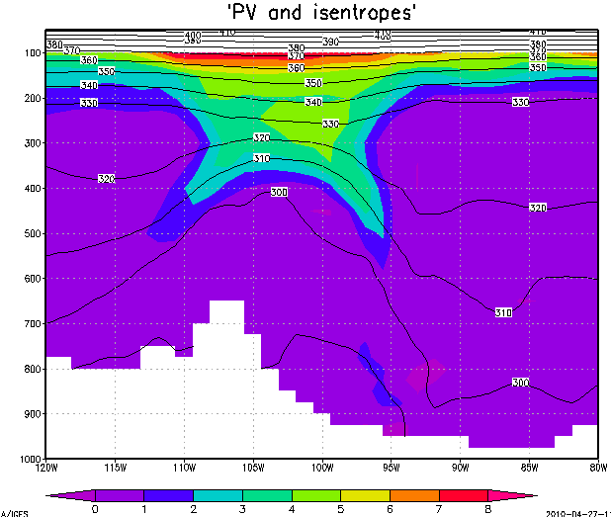


cyclonic ζ
(Trof)
Thermal wind balance prevails: There is a Z trough (trof) for geostrophic balance, with a cold core beneath it, supporting it hypsometrically (in hydrostatic balance).

Slide 36

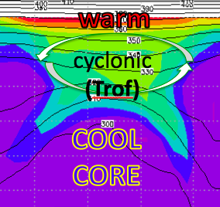

Unsheared advection of T, u, v, vort, PV:
no problem, whole structure moves
cyclonic
(Trof)

Slide 37


Sheared advection breaks thermal wind balance
cyclonic ζ
(Z trof)

Slide 38

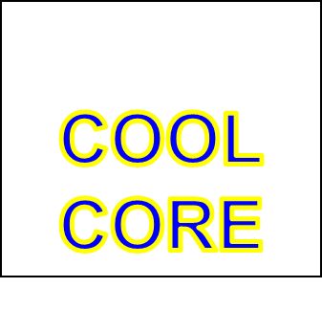
Sheared advection breaks thermal wind balance
Z Trof

Slide 39
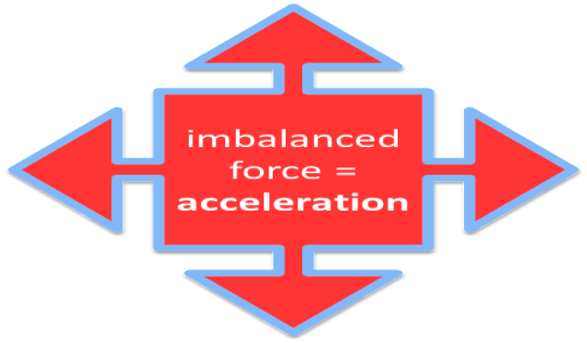
Sheared advection breaks thermal wind balance
Z Trof
L

Slide 40
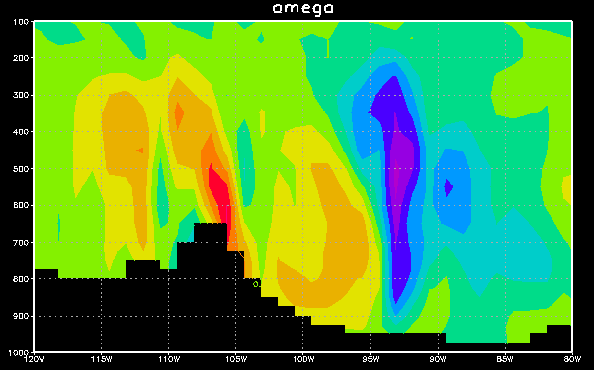
East-west section: omega
→ Z Trof
in order
to create the
needed
cool core
(low ΔZ),
so balance
can again prevail
…

Slide 41
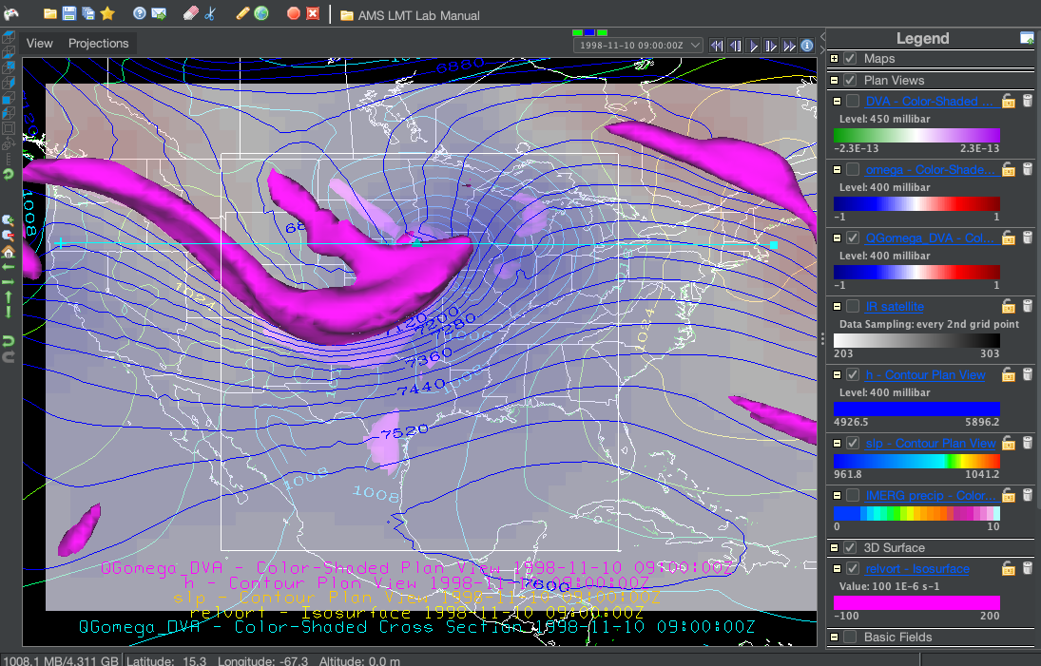
QG omega (vorticity advection term only) computed for this case

Slide 42
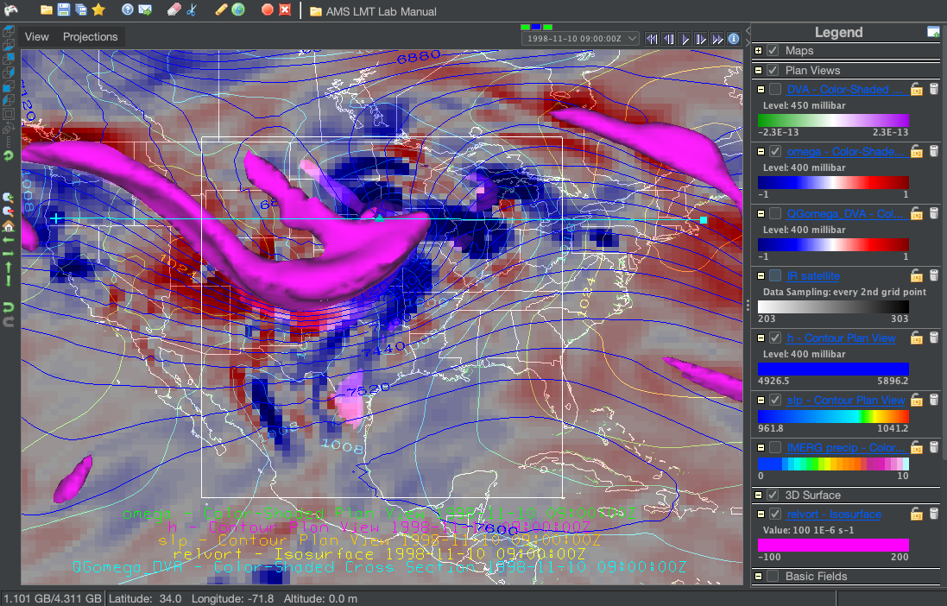
TOTAL omega in MERRA2

Slide 43
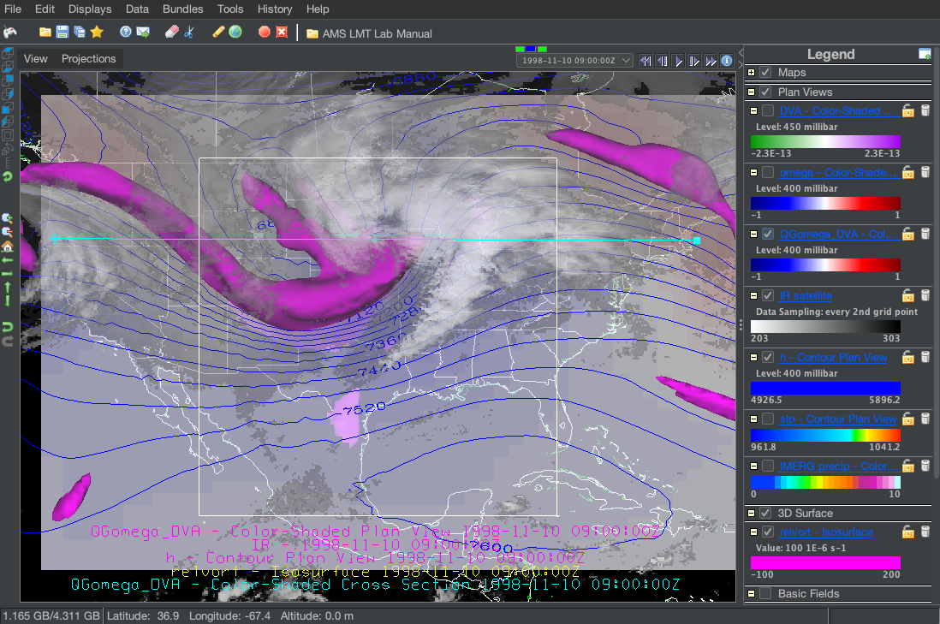
‘Verification’ in the form of satellite IR cloud field

Slide 44
Warm horizontal advection demands even more upward motion, if the cool core is to be built
TROF
cool air flowing south
warm air flowing north
warm air flowing north

Slide 45
East-west section: omega
to build
Z Trof
ascent
creates the
needed
cool core
(low ΔZ),
so that balance
can again prevail
…

Slide 46
Vertical motion and clouds

